Slide 1
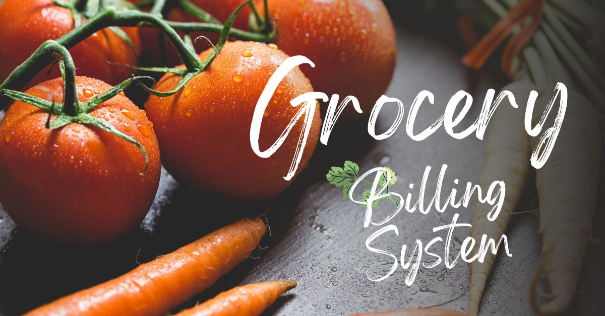
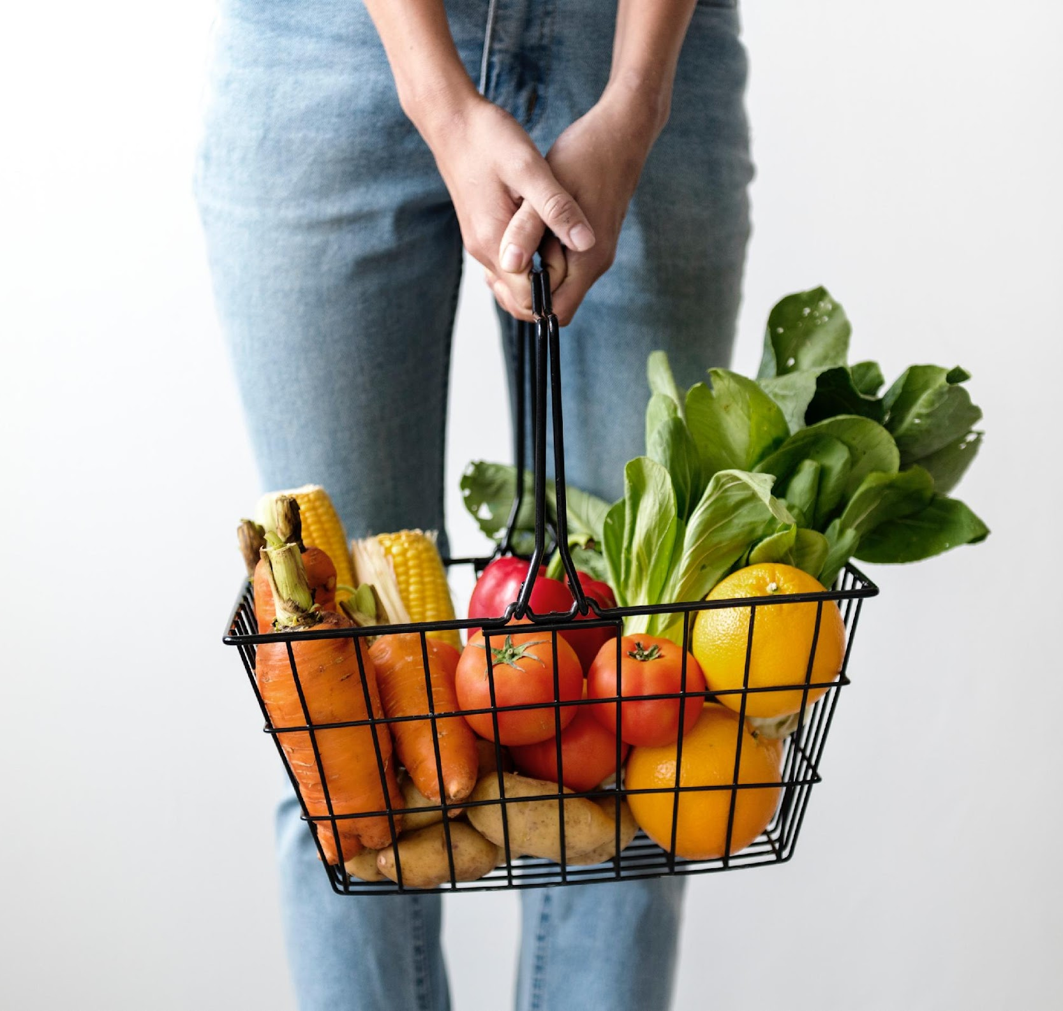



GROCERY BILLING SYSTEM

Slide 2


TEAM MEMBERS:
SHAHUL HAMEED |AP21110010696
SAI KIRAN | AP21110010698
SIVA CHANDU |AP21110010702
SHARASCHANDRA |AP21110010705

Slide 3


01
INTRODUCTION
02
USER REQUIREMENT SPECIFICATION
03
IMPLEMENTATION PROCESS
04
CONCLUSION

Slide 4
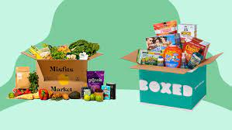
INTRODUCTION
Our project name is “GROCERY MANAGEMENT SYSTEM”. In this project console provides a bill of groceries based on customer requirement. In our project the console will be displayed the list of the items which are needs of customer. Here we will be asking the user to select the items which they desire. Grocery store is the place where customers come to purchase their daily using products and pay for that. There is a need to calculate how many products are sold and to generate the bill for the customer.In our project and implementation we have 3 users. First is the data entry operator who will enter the products in database.Second one is the administrator who will decide the taxes and commissions on the products and can see the report of any product.Third one is the bill calculating operator who will calculate the bill and print.

Slide 5
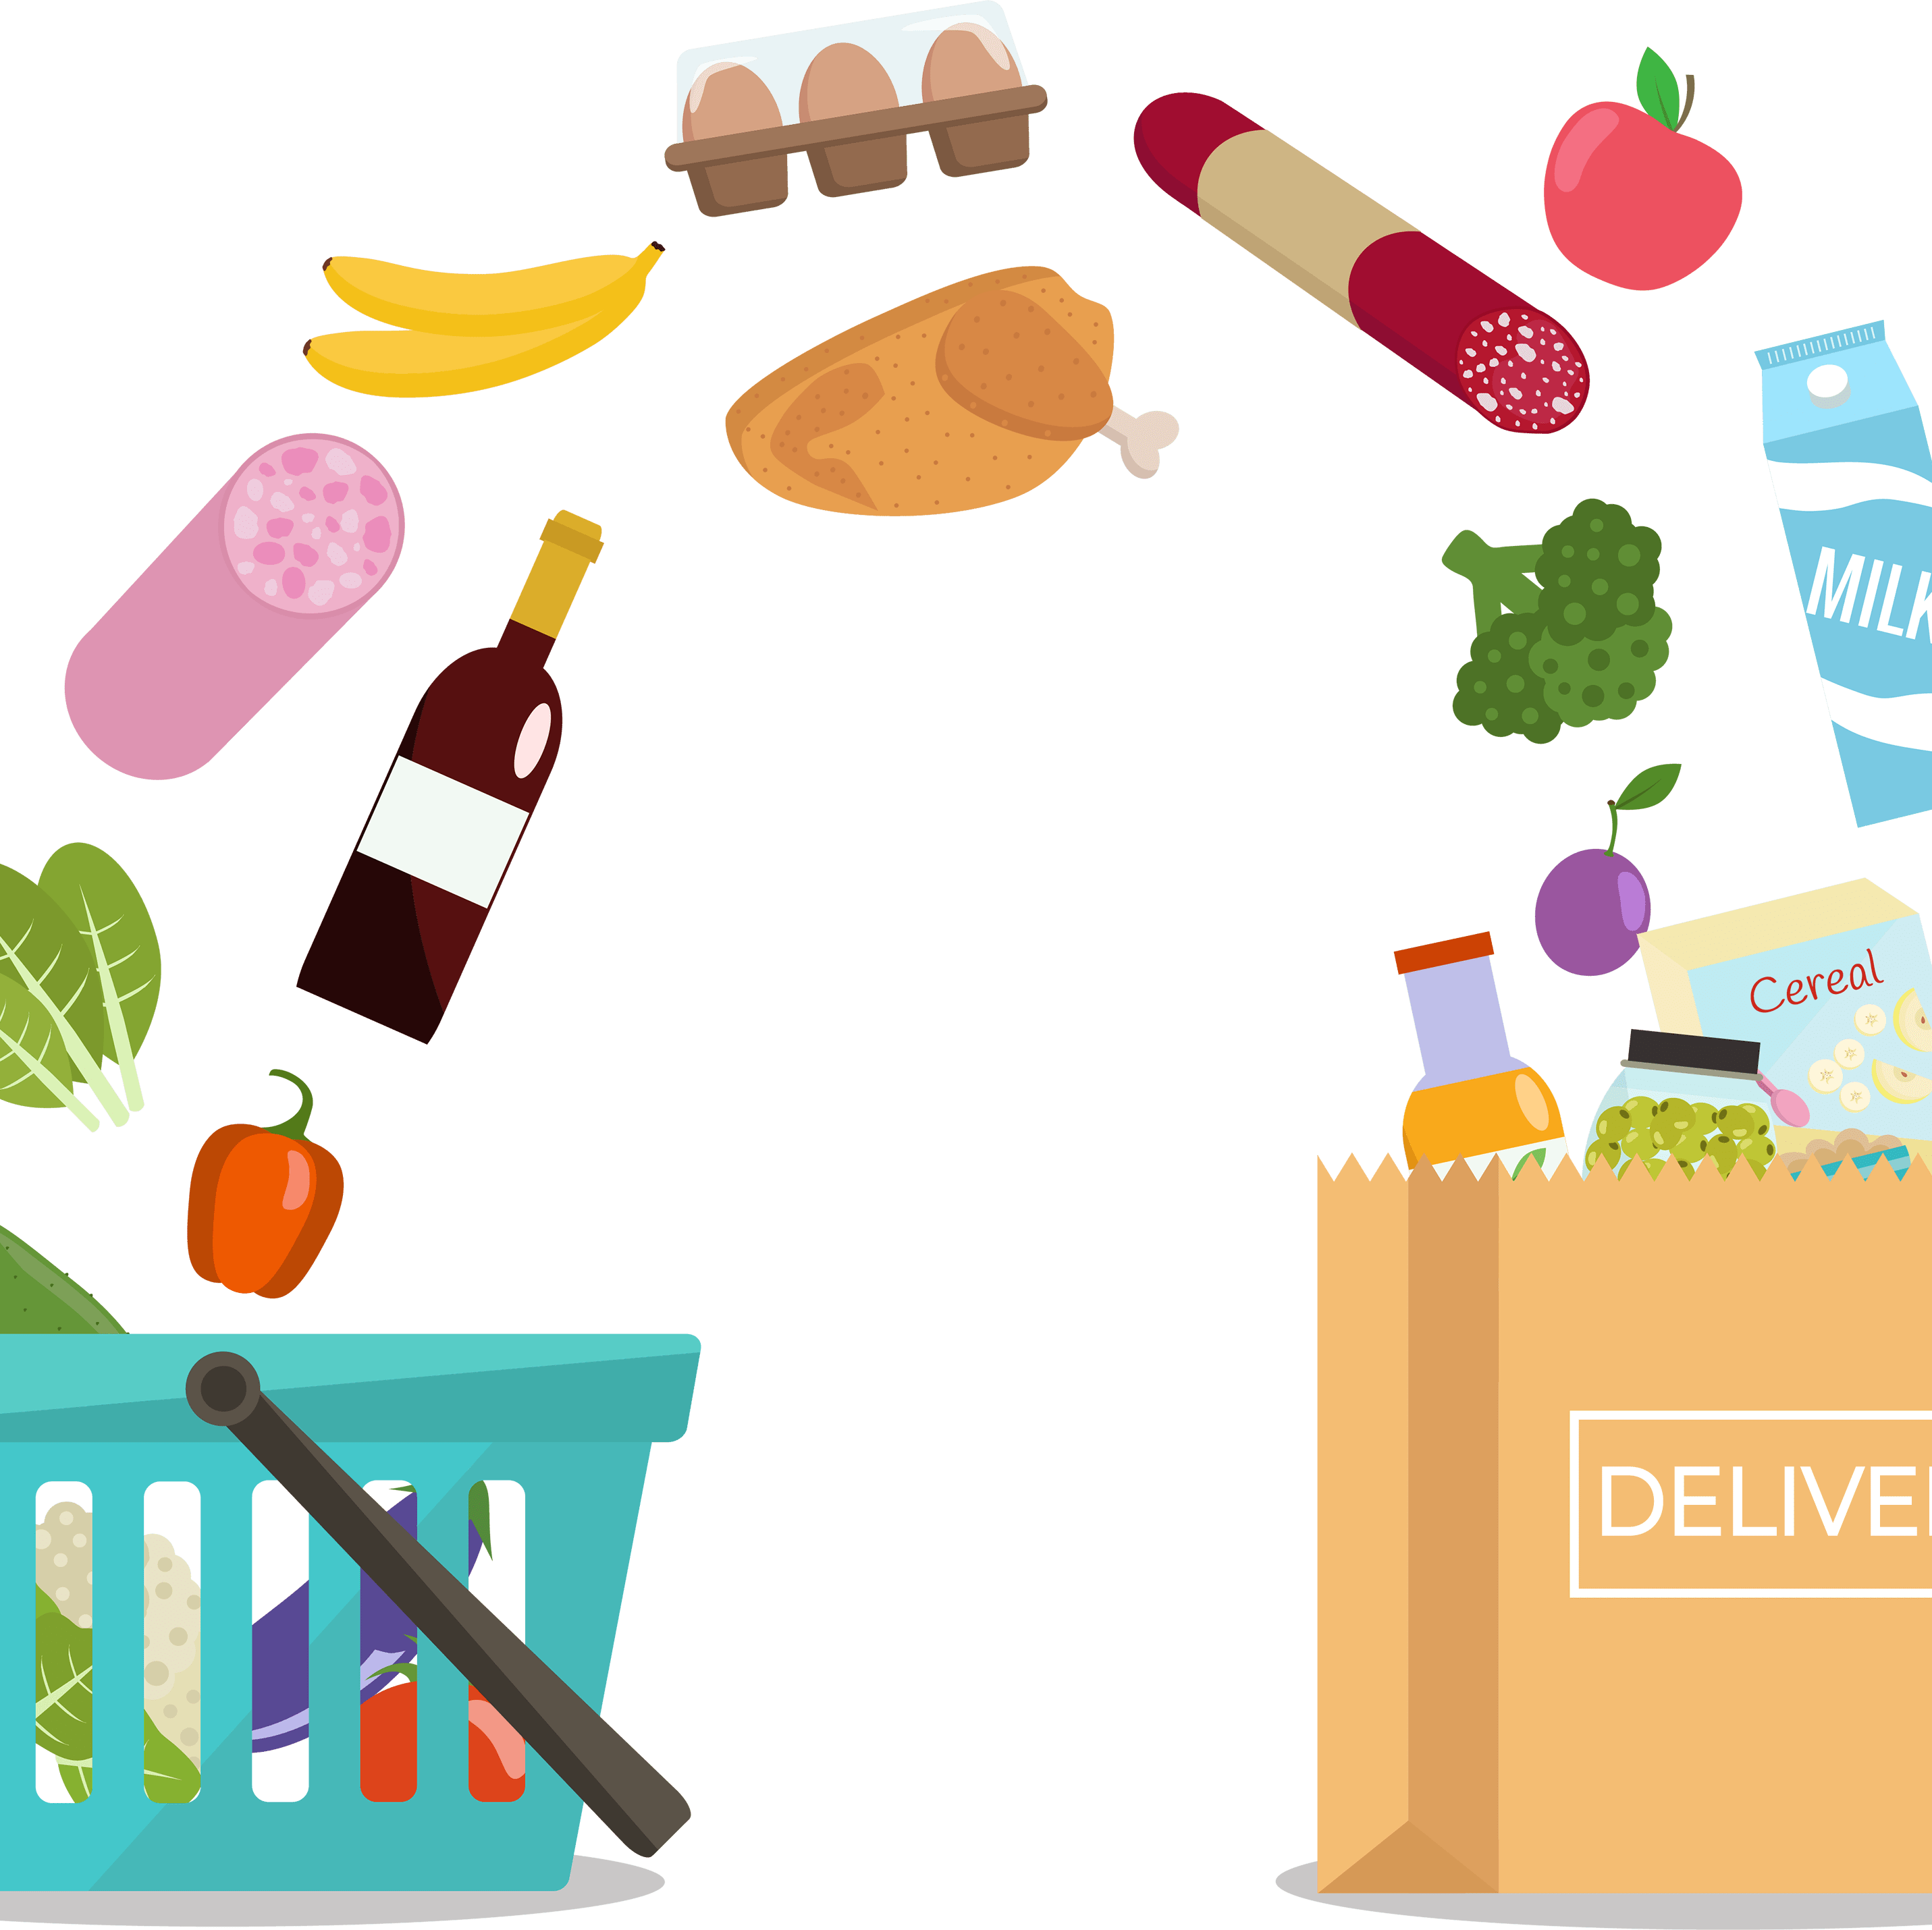
SYNOPSIS:
The grocery billing system is built to calculate and display bills and serve the customer in a faster and efficient manner. This software project consists of an effective and easy Gui to help the employee in easy bill calculation and providing an efficient customer service.

Slide 6
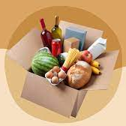
ABSTRACT:
This will help salespersons in managing the various types of records of customer. The product will help the user to work in a highly effective and efficient environment. Salesperson have been recording the customer information in the past and even in the present through their personal manual efforts. In manual system, there are number of inefficiencies that a salesperson faces. The information retrieval is one of the foremost problems. It is very difficult to gather the overall performance reports of the customer. Large record books have to be maintained where relevant and irrelevant information has to be stored. This automation deals with all such problems and tries to remove them in the best suitable fashion. The new system will cater to need of salesperson of any supermarket so that they can manage the system efficiently. The project is developed with the objectives of making the system reliable,

Slide 7
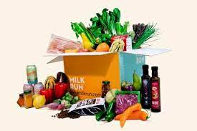
User requirement specification:
Consumers are ultimately looking for brands and chains that ensure safety and the proper precautions are being taken by all employees As a result, there’s a new challenge for grocery chains: 2021 grocery consumers will expect stores to maintain stock levels despite varying availability due to supply chain interruptions and distribution delays As a result, consumers are looking for genuine, kind experiences in the stores they visit because purchases are driven by emotion Today’s consumers are seeking low customer effort for products and services. They want to quickly pick-up item .They expect convenience in the store.

Slide 8

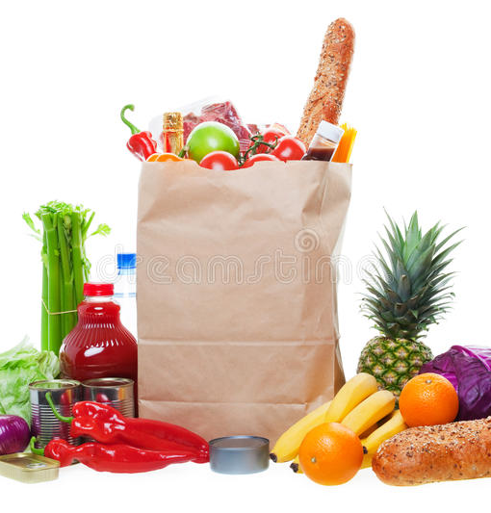
ADVANTAGES:
The grocery billing system is built on the idea to help to help supermarkets calculate and display bills and serve the customer in a faster and efficient manner. Here user may add groceries , vegetables , fruits and snack items. This system makes simple to calculate the bill for each and every item you want to purchase . The entire project was created in the “ python ” programming llanguage using list,dictionaries and files were employed in its construction.
https://www.pexels.com/@mikebirdy

Slide 9
MODULES
*DATE TIME – Used for present date.
*MATH- Provides standard mathematical constants and functions.
*RANDOM- Used to generate Random number.

Slide 10

CONCLUSION:
Billing system for grocery shop will help in creating many new opportunities for future research to evaluate new ideas in the field of online shopping as the customer will be able to benefit from these types of applications and purchase items in an efficient manner. Helps in better understanding and decision making. We explained the technology and method behind it. The reverse smooth experience of this system. Throughout the cycle of trying different objects in this environment. Unlike traditional systems, it offers additional benefits. Currently, the designed system is limited to simple applications, but the system can be used as a basis for more complex AR systems. We are currently using 3 models; These can also be replaced by inventor. This type of system can also be developed at various online shopping stores when using a mobile or any other such compatible device. Therefore, at a time when market share is growing and a dangerous virus is spreading around the world, we have realized the importance of online shopping and user experience on the platformo

Slide 11



